Slide 1
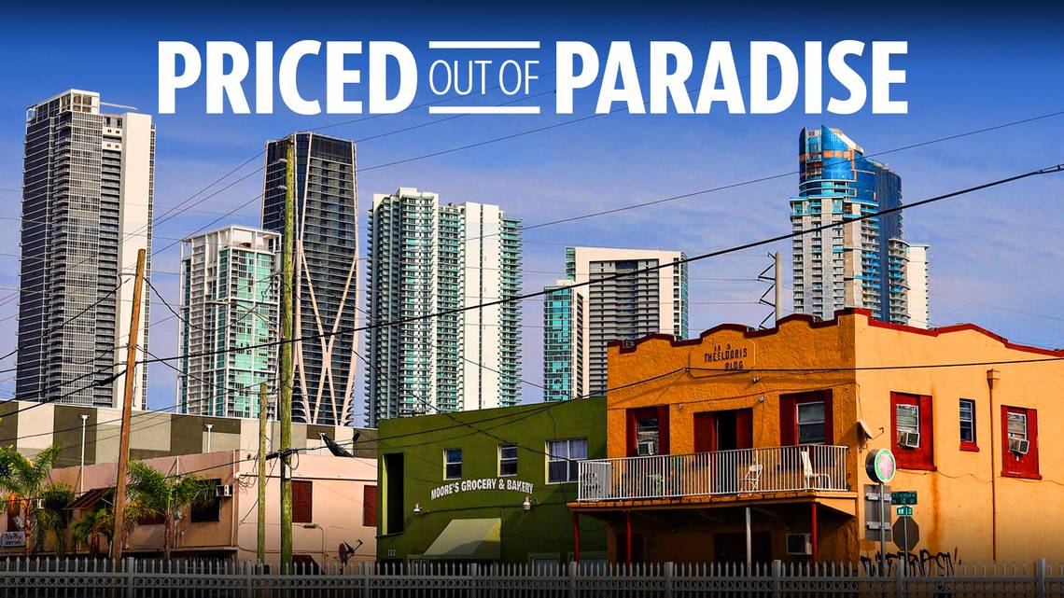
Examining a link between restaurants
and gentrification in Miami
ETL Data project by CHAMPS:
Monica Alarcon, Abraham Benaim, Craig Hall

Slide 2
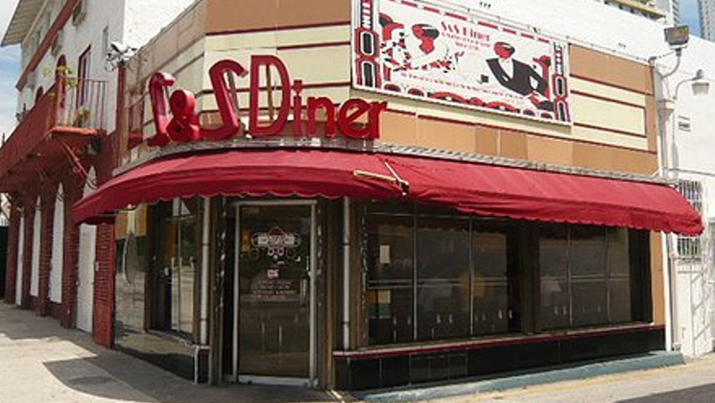
PREMISE
We set out to find a correlation between
the number of restaurants in a zip code and gentrification.

Slide 3
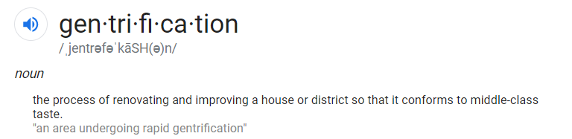

We theorized that neighborhoods in the process of being gentrified may be identified by examining zip codes where rental rates and the asking price of homes and condos are significantly higher than the fair market value.

Slide 4
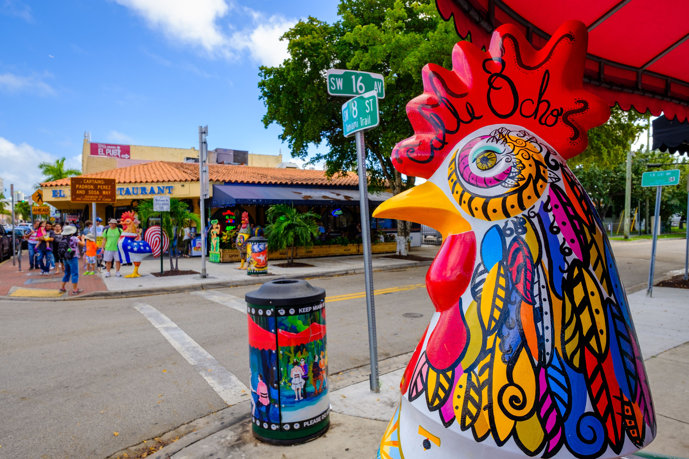
Resources and Processes
Zillow – downloaded CSV of zip codes in Miami, “Zestimates®” (Zillow’s value estimates), rental rates. Imported into Python. Removed uneccesary columns, and zip codes with NaN values.
Census.gov – downloaded CSV of census data for home values for zip codes in Miami-Dade. Imported into Python; used Pandas to clean and transform the list.
Yelp – made API call to Yelp to pull restaurant name, address, zip code, and price index.
Used Pandas to join the data, and created a PostgreSQL database.
# With additional time, would use MatPlotLib to chart the neighborhoods with the highest difference between actual value and asking/selling prices, overlaid with the number of restaurants in those neighborhoods (compared to the average number of restaurants per zip code).

Slide 5
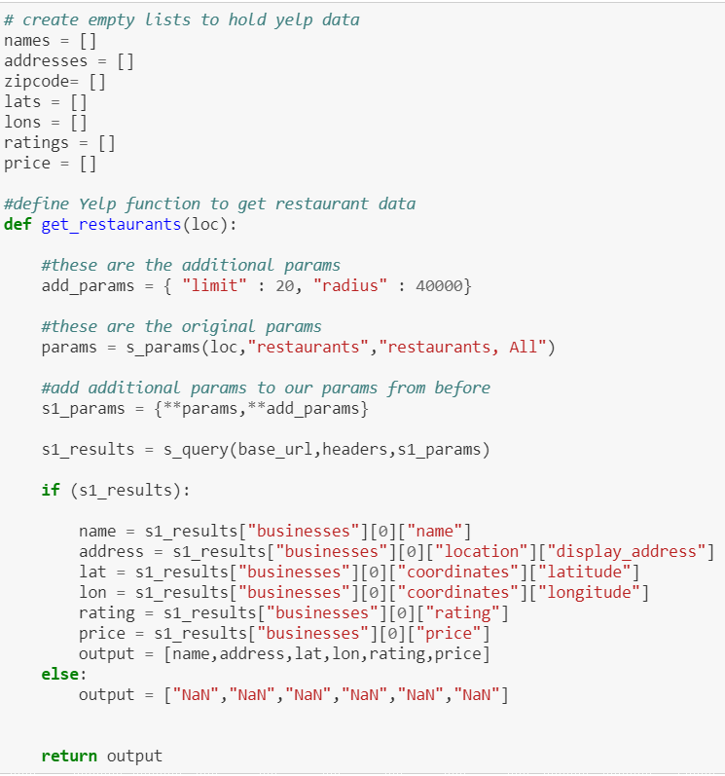
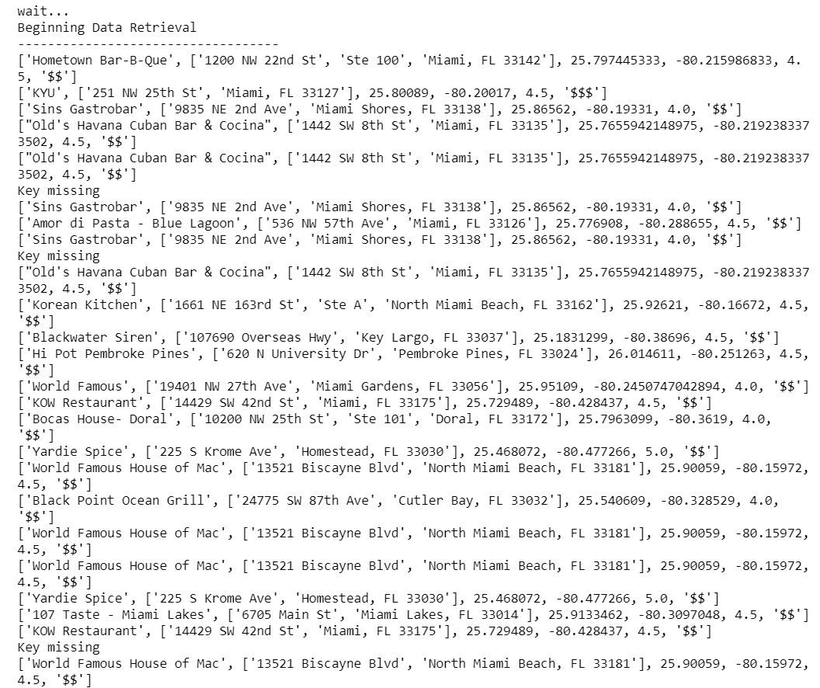
List results retrieved from Yelp API call
Example of Python code creating empty lists and cycling through Yelp API to grab restaurant information

Slide 6
Extract
Transform
Load
Zillow
Python
PostgreSQL
Yelp
Census.gov

Slide 7

SUMMARY: FINDINGS AND PROCESS

